Slide 1
Session 5
U D D I

Slide 2
Session Objectives
Explain what is UDDI
Discuss the need for UDDI
Search the UDDI registries
Describe the data structure model used in UDDI
Discuss the fields present in the data structures

Slide 3

Using Web Services
Available services
Need for services
EMI Service
Search
Register
Interest Calc
Interest Calc
UDDI
EMI Service
Business service
....

Slide 4
UDDI
Register
UDDI
Search
Services
Need Services
Stands for Universal Description, Discovery and Integration
Helps businesses to:
Describe the business and the services offered by them
Discover other businesses, which may be of some assistance
Integrate with other businesses for expansion

Slide 5


UDDI Business Registry
Aims at integrating e-commerce sites
Industries
Markets
&
Search Engines
UDDI
Business
Registry
(UBR)
Business
Register / Search

Slide 6

Working of UDDI
XML File
Submitted to
UDDI
White
Pages
Yellow
Pages
Green
Pages
Includes
address,
contact etc.
Technical information about the services
Industrial
Category
information

Slide 7





UDDI Business Registry (UBR)
Registrar
UBR
??? Future
Nodes ???
Existing
Nodes
Replicated daily
Register Directly

Slide 8
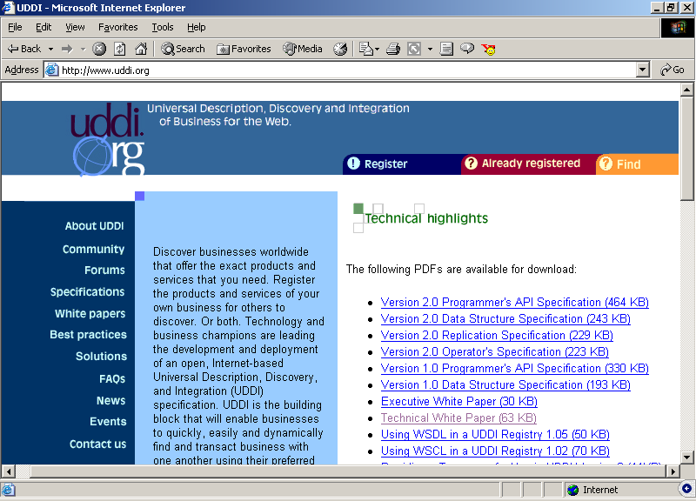
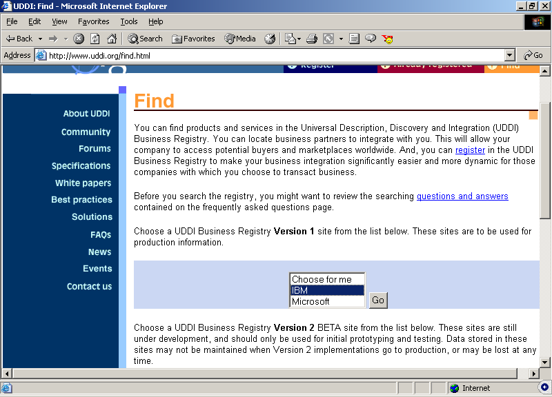
Finding a Web Service (1)
Go to the site http://www.uddi.org
Click
Choose a node

Slide 9
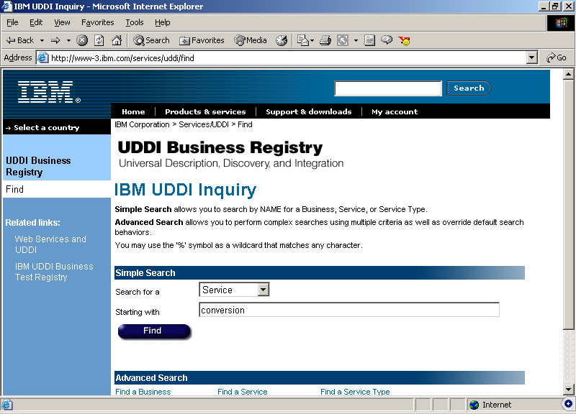
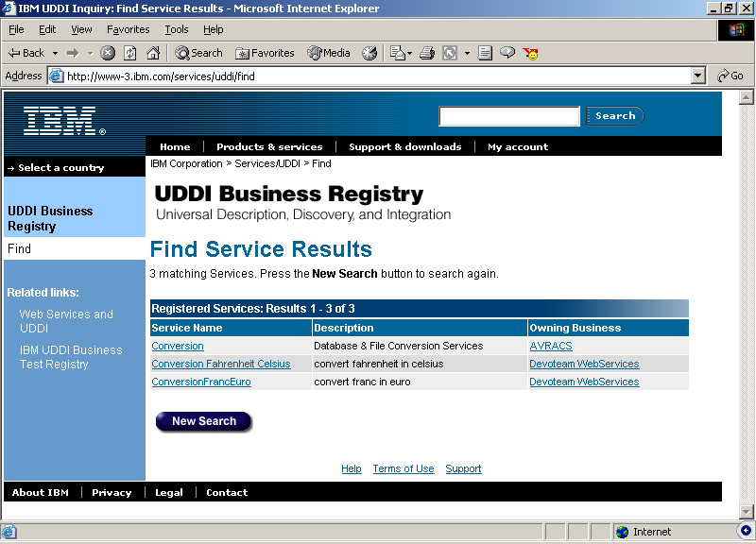
Finding a Web Service (2)
Filling the search criteria

Slide 10
Registry Architecture and Data Structures
White
Pages
Yellow
Pages
Green
Pages
businessEntity
(bE)
bindingTemplate
(bT)
publisherAssertion
(pA)
businessService
(bS)
tModel
bE
bE
pA
pA
bS
bS
bS
bS
bS
bS
bT
bT
bT
bT
tModel
tModel
tModel
tModel

Slide 11
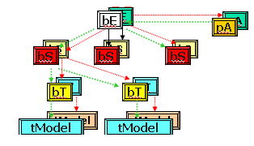
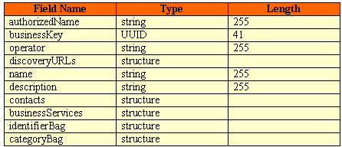
businessEntity
Contains information about the party that publishes descriptive information

Slide 12
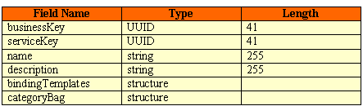
businessService
Structure represents a logical service classification

Slide 13
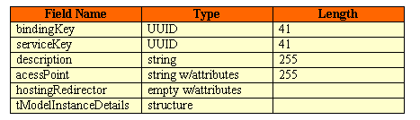
bindingTemplates
Provides the technical descriptions about the web service

Slide 14
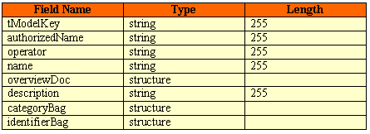
tModel Structure
Represent technical information.
Illustrates the manner in which web service could be
interacted with.

Slide 15

publisherAssertion
publisherAssertion data structures bear references to business entities

Slide 16

Web Services and UDDI
UDDI: A service on the web which helps locate a web service
UDDI
Search
Client needs a web service
Find
A Collection of Web Services

